Slide 1
POTENTIAL IMPACTS
OF ARTIFICIAL INTELLIGENCE (AI) ON ISLAM AND MUSLIMS
01

Slide 2
ABOUT THE FACILITATOR
Name: Hussain Bin Hyacinth
BA., M.Sc., M.Phil. & Ph.D. in view, Communication & Media Studies
(Khartoum & Lagos)
Senior Broadcast Journalist (VON), & Consultant Trainer, TrainApplyS for HR Management, Lagos.
Certified Professional Trainer (CPT), UK. & Cairo.
Certified Accelerated Learning Practitioner (CALP), Dubai.
Trained over 5, 000 people within & outside Nigeria; with more than 20 years of training experience & 10, 000 of training hours.
02

Slide 3

WHAT IS THE RELEVANCE
/SIGNIFICANCE OF THIS TOPIC
03

Slide 4
WHAT IS ARTIFICIAL INTELLIGENCE (AI)
A field of computer science and engineering that can perform tasks that would normally require human intelligence, such as learning, problem-solving, perception, decision-making, and language understanding. AI systems are designed to learn from data and improve their performance over time through a process called machine learning, which involves training algorithms on large datasets.
03

Slide 5
TYPES OF AI
BASED ON CAPABILITIES:
Narrow AI
(Weak AI)
Artificial General Intelligence (AGI)
Aka: Strong AI
SUPER AI
AGI can use previous learnings and skills to accomplish new tasks in a different context without the need for human beings to train the underlying models.
If ever realised, Super AI would think, reason, learn, make judgements and possess cognitive abilities that surpass those of human beings.
What presently exists, others theoretical. Narrow AI is trained to perform a narrow single task, often far faster than a human
05

Slide 6
BASED ON FUNCTIONALITIES:
Reactive Machine AI | Limited Memory AI | Theory of Mind AI | Self-Aware AI
AI systems with no memory and are designed to perform a very specific task. Since they can’t recollect previous outcomes or decisions, they only work with presently available data. Reactive AI stems from statistical math and can analyse huge amounts of data to produce a seemingly intelligent output. | It can recall past events and outcomes and monitor specific objects or situations over time. Limited Memory AI can use past- and present-moment data to decide on a course of action most likely to help achieve a desired outcome. Generative AI tools like ChatGPT, Bard and DeepAI rely on limited memory AI capabilities to predict the next word, phrase or visual element within the content it’s generating. Virtual assistants and chatbots: Siri, Alexa, Google Assistant, Cortana and IBM Watson Assistant combine natural language processing (NLP) and Limited Memory AI to understand questions and requests, take appropriate actions and compose responses. Self-driving cars: Autonomous vehicles use Limited Memory AI to understand the world around them in real-time and make informed decisions on when to apply speed, brake, make a turn, etc. | When realised, TOM will understand the thoughts and emotions of other entities. This understanding can affect how the AI interacts with those around them. It would allow the AI to simulate human-like relationships. | Like TOM AI, Self-Aware AI is strictly theoretical. If ever achieved, it would have the ability to understand its own internal conditions and traits along with human emotions and thoughts. It would also have its own set of emotions, needs and beliefs.
06

Slide 7

Can AGI, SUPER AI, TOM and SELF-AWARE AI be realised
07

Slide 8
The answer to the question is contained in this statement of Allah in which He says:
وَٱلۡخَيۡلَ وَٱلۡبِغَالَ وَٱلۡحَمِيرَ لِتَرۡكَبُوهَا وَزِينَةٗۚ وَيَخۡلُقُ مَا لَا تَعۡلَمُونَ ٨
Unknown technologies/
inventions
Known technologies/
inventions
08

Slide 9
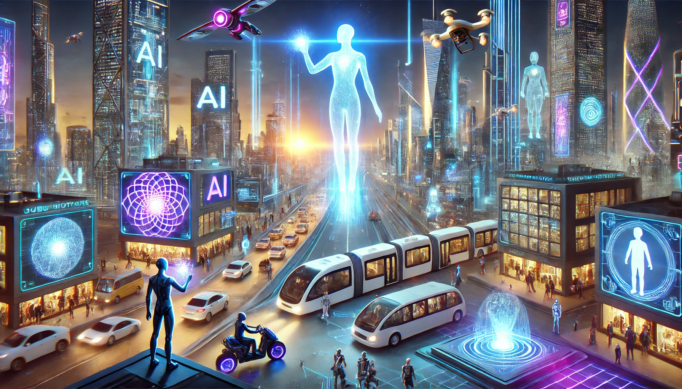
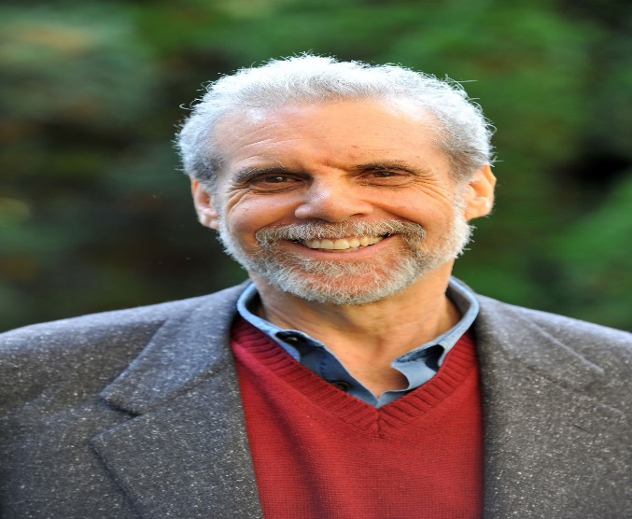
FUTURE AI,
4 DOMAINS OF EI
& THE IMPOSSIBLE
وَيَسۡ‍َٔلُونَكَ عَنِ ٱلرُّوحِۖ قُلِ ٱلرُّوحُ مِنۡ أَمۡرِ رَبِّي وَمَآ أُوتِيتُم مِّنَ ٱلۡعِلۡمِ إِلَّا قَلِيلٗا ٨٥
SA
SM
SA
RM
Daniel Goleman
09

Slide 10
AI
HUMAN
Made up of dust only, and powered with electric energy.
Made up of dust and brought to life through breathing a soul into him.
The essence of the energy is fully known
There is just little knowledge about the soul
10

Slide 11
WHAT IS THE RULING OF AI
11

Slide 12
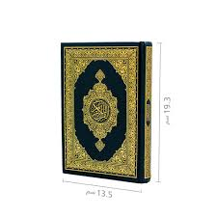
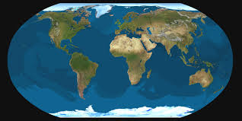
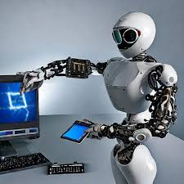
THE RULING OF AI
هُوَ ٱلَّذِي خَلَقَ لَكُم مَّا فِي ٱلۡأَرۡضِ جَمِيعٗا ٢٩
وَٱللَّهُ خَلَقَكُمۡ وَمَا تَعۡمَلُونَ ٩٦
12

Slide 13
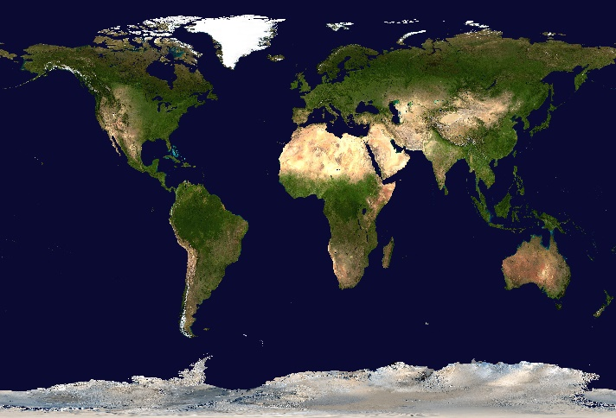
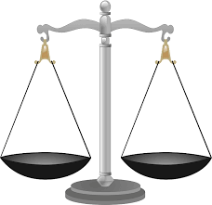

THE RULING OF AI
أنتم أعلم بأمور دنياكم
الأصل في الأشياء إباحة حتى يأتي دليل على حرمتها
13

Slide 14

POTENTIAL IMPACTS OF AI ON ISLAM
INFORMATION DISORDER
1
MISINFORMTION: False information that is shared by mistake.
Key feature: The person sharing it believes it is true.
Example: Forwarding an unverified statement attributed to the Prophet ﷺ on WhatsApp because you think it might be of help to Muslims.
14

Slide 15
POTENTIAL IMPACTS OF AI ON ISLAM
INFORMATION DISORDER
2
DISINFORMTION: False information that is created, shared, or amplified deliberately to deceive or cause harm.
Key feature: Intentional manipulation.
Example: Christian genocide claim by IPOP, Trump, etc.
15

Slide 16
POTENTIAL IMPACTS OF AI ON ISLAM
INFORMATION DISORDER
3
MALINFORMTION: Genuine, factual information that is used out of context, leaked, or weaponised to cause harm.
Key feature: Information is true, but its use is harmful.
Example: Releasing private/secret messages of a person or organisation in order to damage their reputation.
16

Slide 17
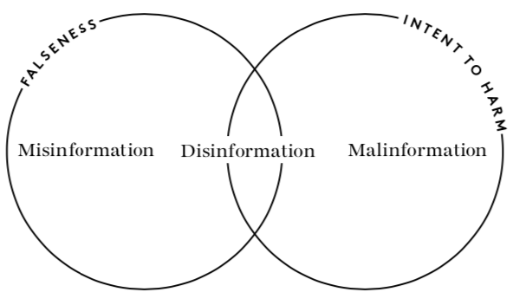

Misinformation
Disinformation
Malinformation
يَٰٓأَيُّهَا ٱلَّذِينَ ءَامَنُوٓاْ إِن جَآءَكُمۡ فَاسِقُۢ بِنَبَإٖ فَتَبَيَّنُوٓاْ أَن تُصِيبُواْ قَوۡمَۢا بِجَهَٰلَةٖ فَتُصۡبِحُواْ عَلَىٰ مَا فَعَلۡتُمۡ نَٰدِمِينَ ٦
كفى بالمرء إثما أن يحدث بكل ما سمع
17

Slide 18
AI & INFORMATION MNIPULATION
Changing, twisting, hiding, exaggerating, or presenting information in a misleading way in order to influence how people think, feel, or behave
It does not always involve a full lie. Sometimes it is half-truth, selective truth, or emotional framing that misleads people.
18

Slide 19
AI & INFORMATION MNIPULATION
Source Manipulation: Changing or hiding who the information is coming from.
Using fake identities
Pretending the information is from a trusted person
Hiding the real sponsor or agenda
19

Slide 20
AI & INFORMATION MNIPULATION
Message Manipulation: Changing what is being said.
Adding false details
Leaving out important facts
Exaggerating or downplaying parts
Editing photos, quotes, or videos
20

Slide 21
AI & INFORMATION MNIPULATION
Audience Manipulation: Targeting who receives the message and how they are influenced.
Using emotional language
Playing on fear, anger, or sympathy
Tailoring messages to specific groups
Spreading content designed to divide or provoke
21

Slide 22
AI & INFORMATION MNIPULATION
Context Manipulation: Misrepresenting where, when, or how information is used.
Presenting old news as new
Taking quotes out of context
Using true information at the wrong time to mislead
22

Slide 23
AI & INFORMATION MNIPULATION
Context Manipulation: Misrepresenting where, when, or how information is used.
Presenting old news as new
Taking quotes out of context
Using true information at the wrong time to mislead
23

Slide 24
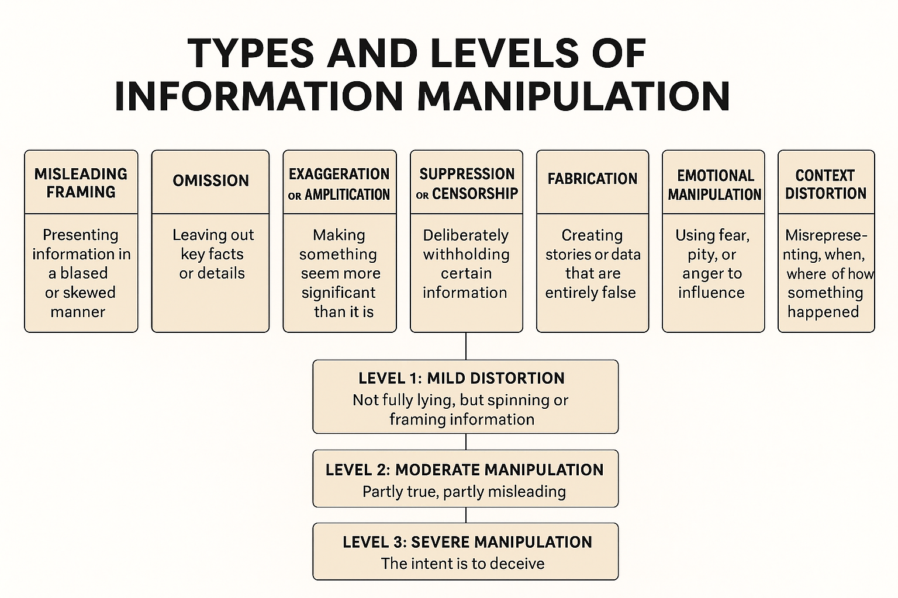
24

Slide 25
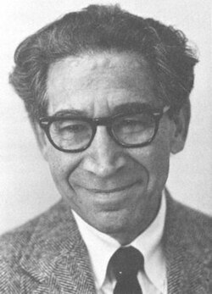
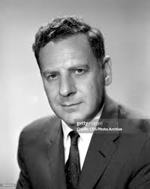
SELECTIVITY PROCESSES
Cognitive Dissonance
Selective Exposure
Leon Festinger (1957)
Joseph T. Klapper (1960)
25

Slide 26
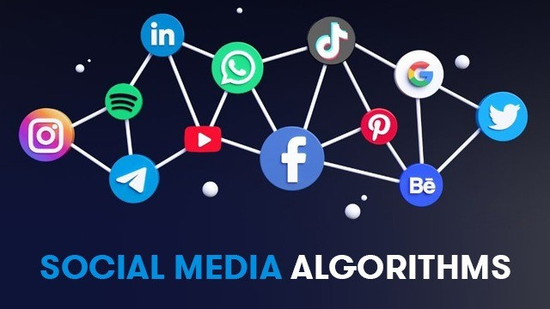
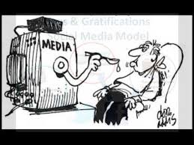
ALGORITHMS
Big tech companies implement the studies of Festinger (1957) and Klapper (1960) through the use of AI to gratify you.
26

Slide 27



DATA COLONIALISM
Coined by Nick Couldry & Ulises Ali Mejias
Nothing is free, even in Freetown.
When you chat and watch videos for free on social media, YOU ARE RATHER THE COMMODITY BEING SOLD OR TRADED!
27

Slide 28
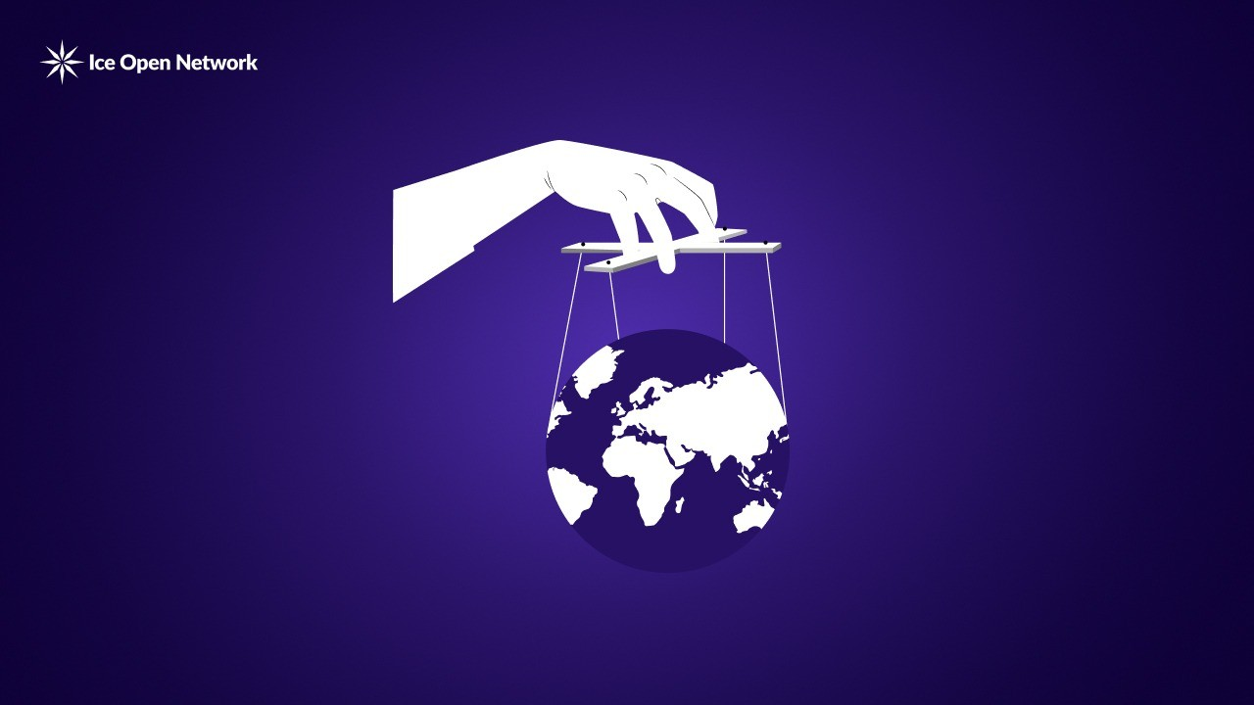
DATA COLONIALISM: How It Works
Because, just like old colonialism:
A few powerful big tech companies your data.
You supply them vital information about your behaviour, location, photos, messages, clicks, etc.
The powerful actors benefit the most, making money from targeted advertising, surveillance, and digital control.
So, instead of taking your land as they did before, they take your
personal data.
28

Slide 29
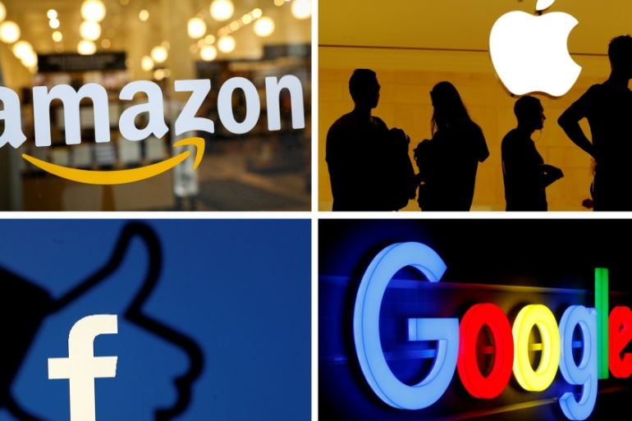
DATA COLONIALISM: The Risks?
Loss of privacy - you don’t know who has your data or how it is being used.
Dependency - countries rely on foreign tech infrastructure.
Economic exploitation - others profit from your data while users get little or nothing.
Control and influence - data can be used to shape opinions, behaviour, or even politics.
29

Slide 30
DATA COLONIALISM: The Risks?
Big Tech companies have no qualms. They amass profits while their products are used to incite violence and spread disinformation.
More dangerous, have you ever imagined sensitive information, sources of legislation of Islam being in the possession and control of enemies of Islam
30

Slide 31

AI & CYBER WAR OF FATWA
31

Slide 32
AI & ISSUANCE OF FATWA
32

Slide 33
Jazakumul Lahu khayran!
We Feel Honoured Indeed
Being With You All This While.
FOR HR MANAGEMENT
13
33

