Slide 1

Prospects and Problems of Artificial Intelligence
Prof. Abiodun Musa Aibinu,
Vice-Chancellor/Chief Executive and Academic Officer,
Summit University Offa,
Kwara State, Nigeria.
Beyond 5G: Light Fidelity (Li-Fi)
www.summituniversity.edu.ng

Slide 2
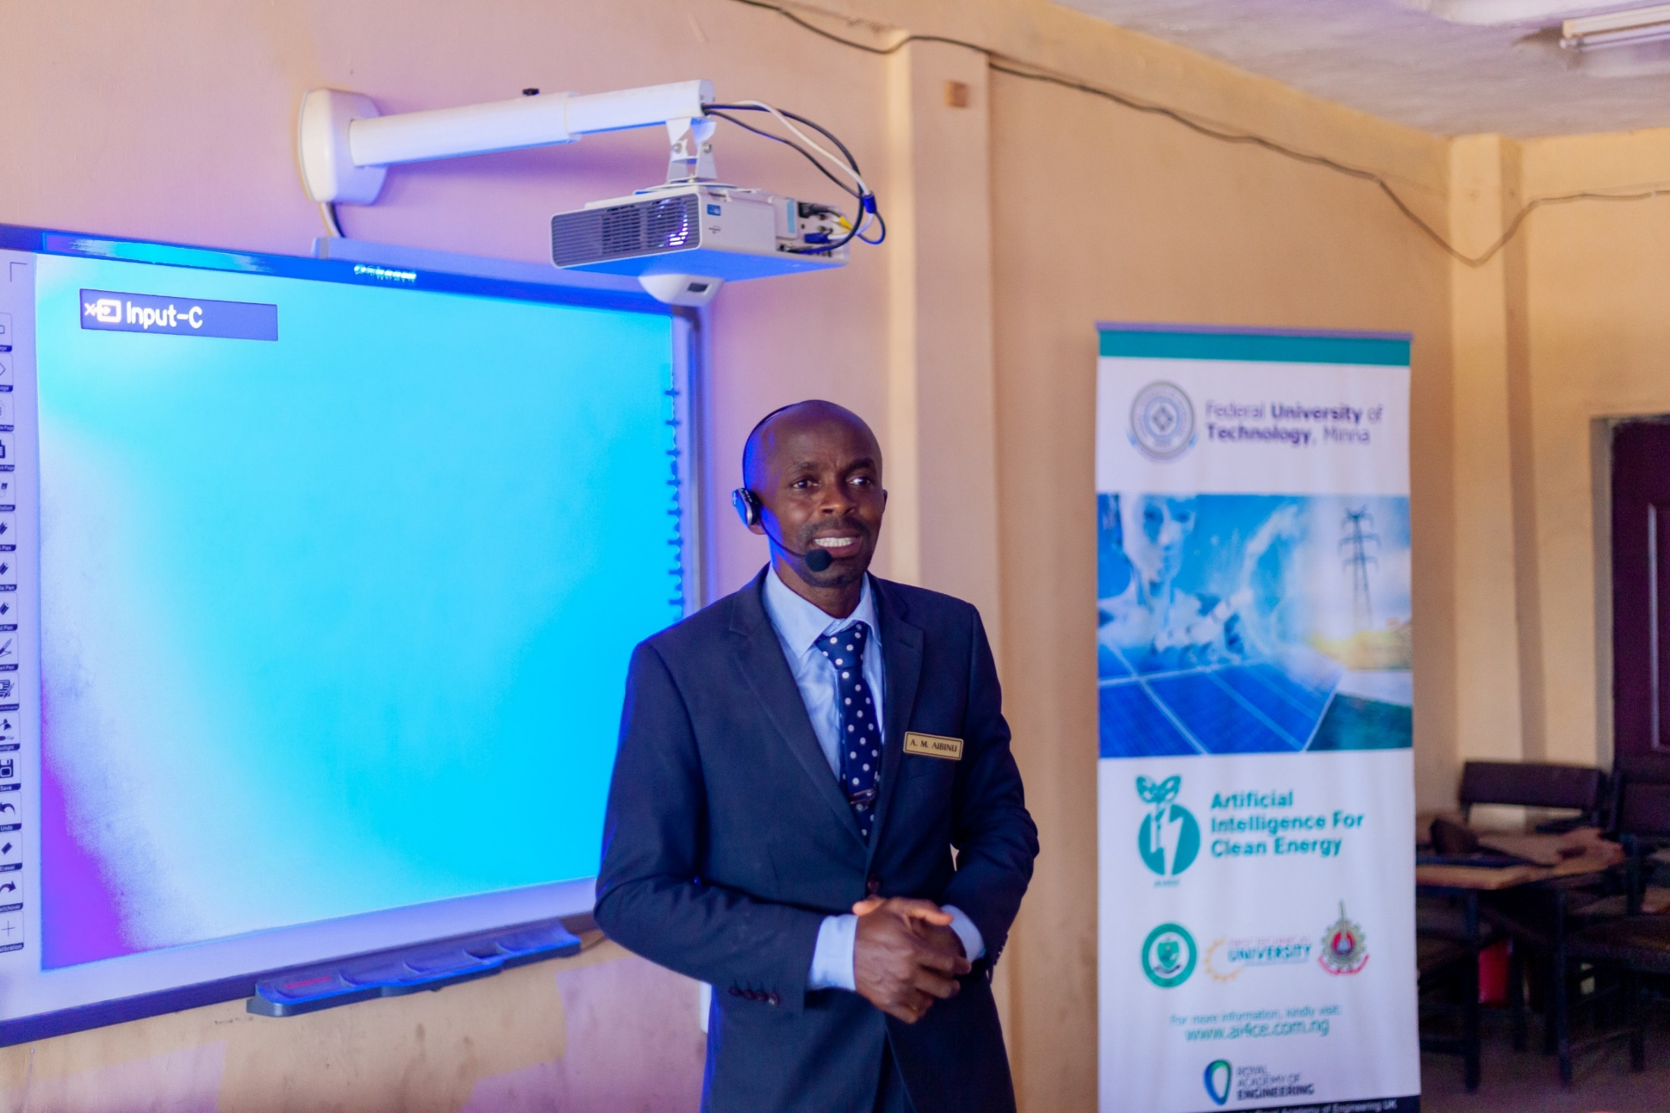
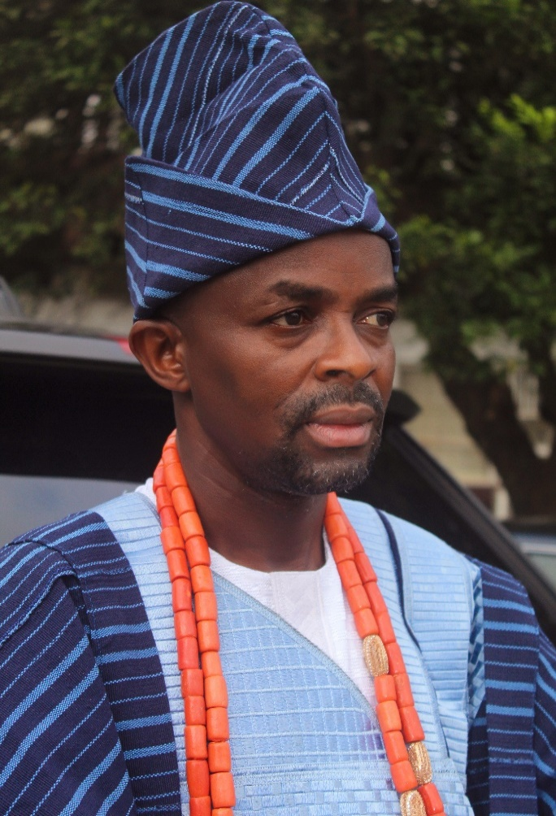
Mogaji Aikulola-Aibinuomo Family,
Ita Abigbo, Oranyan,
Ibadan, Oyo State.
Abiodun Musa Aibinu
The Vice-Chancellor,
The Chief Executive and Academic Officer,
Summit University, Offa, Kwara State, Nigeria.
vc@summituniversity.edu.ng,
maibinu@gmail.com,
+2348029494164

Slide 3
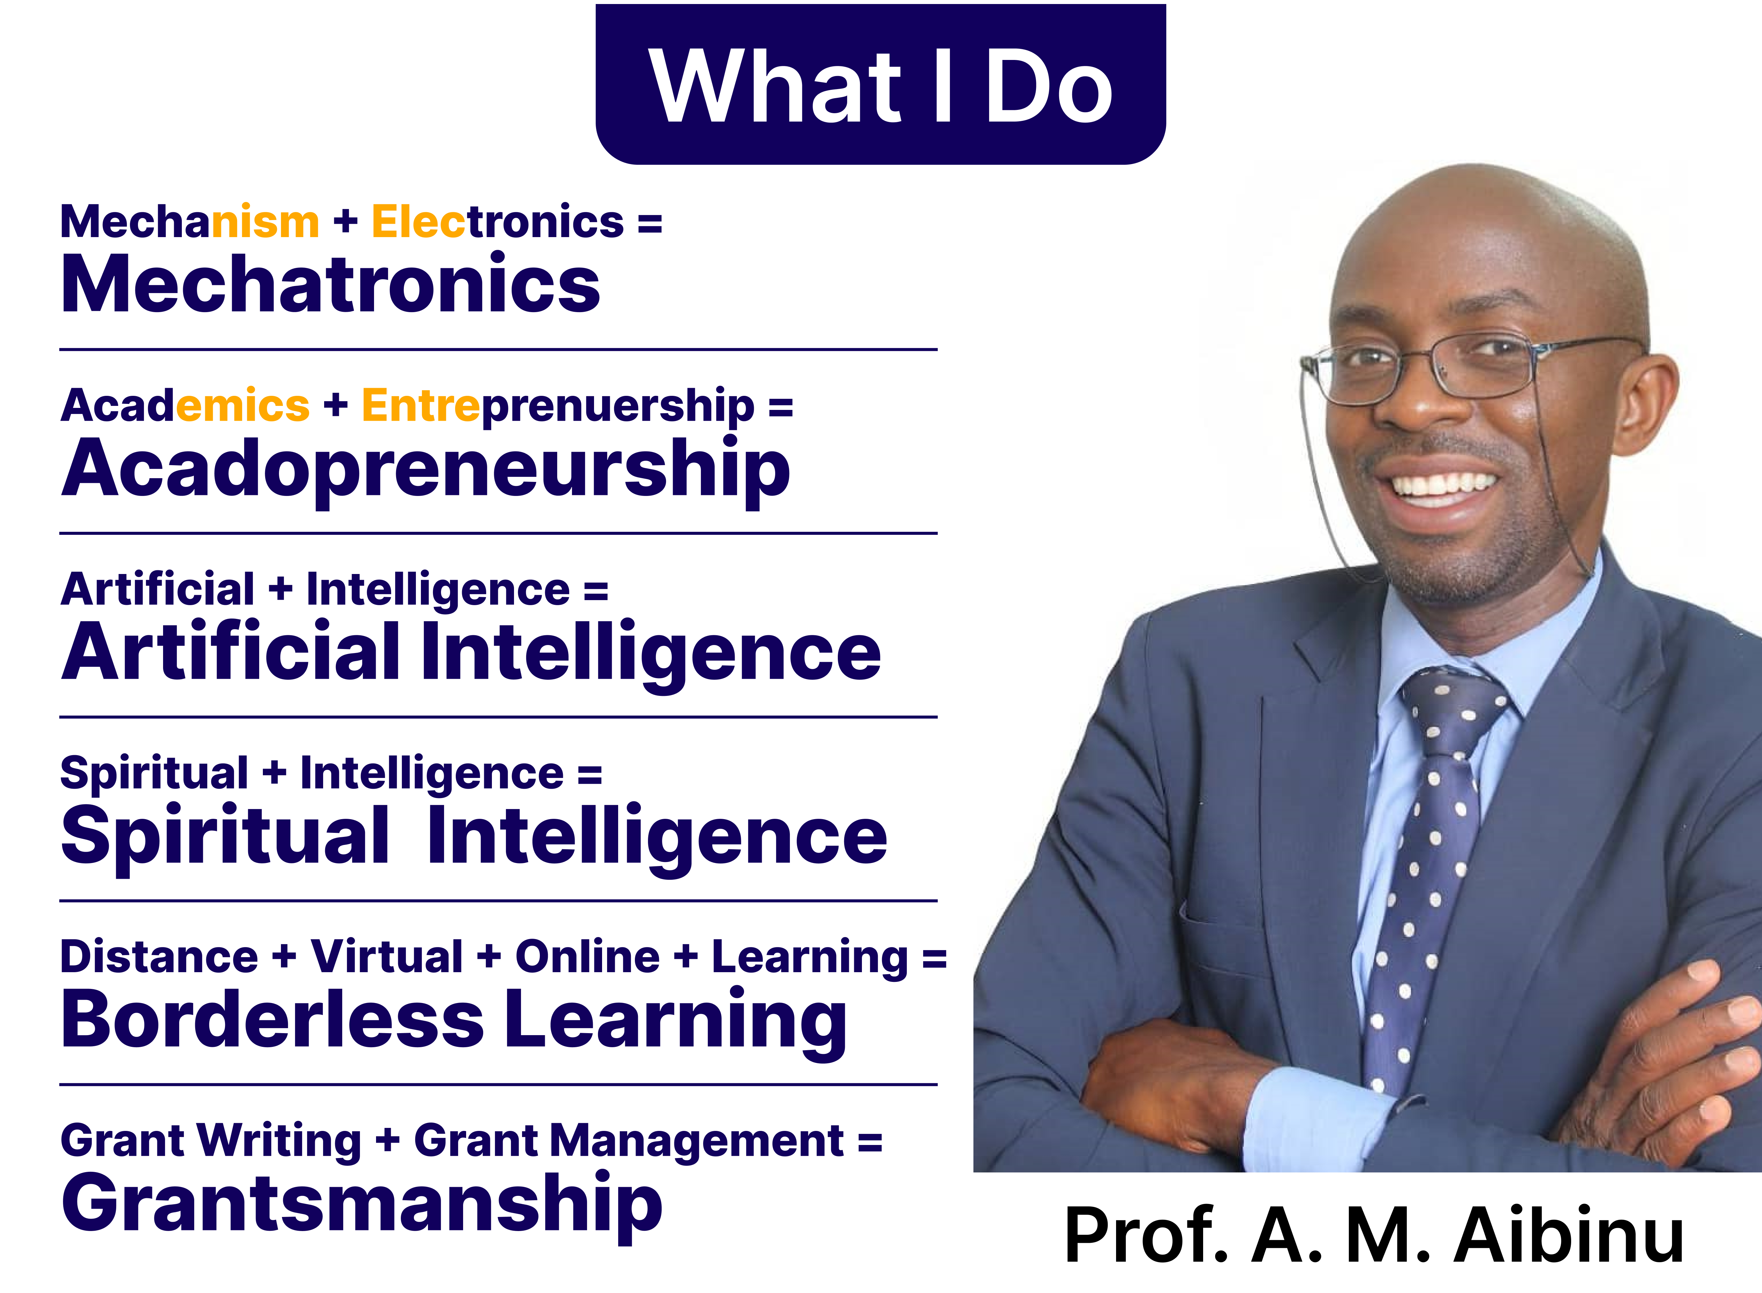
About the Presenter

Slide 4
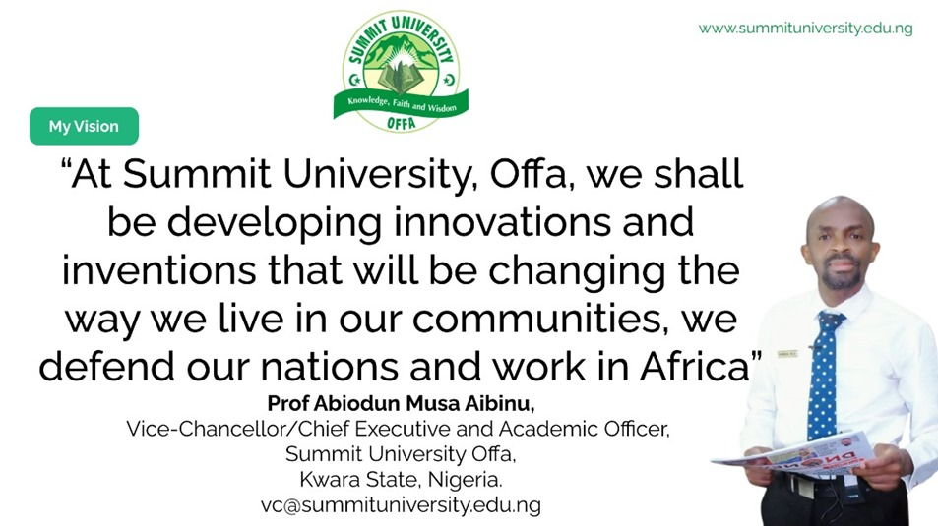

Slide 5
Overview
This presentation explores the opportunities and challenges of Artificial Intelligence for Muslims and society.
It highlights the prospects of Artificial Intelligence in education, healthcare, economy, and daily life, examines potential problems, and presents Islamic ethical guidelines for responsible and beneficial use of technology.

Slide 6
Will Artificial Intelligence serve humanity or control it?
Notes:
Discuss that it is
A software
Being in use in over 300 countries
However, due to the uniqueness of Nigerian system the developed techniques could not be applied to Nigerian case
The use of AVLPRS
Access control
Toll gate control
Trafic control
Crime fighting
Location of stolen vehicles etc

Slide 7
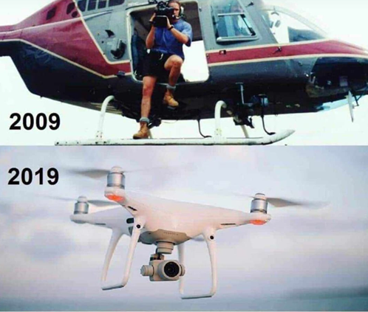
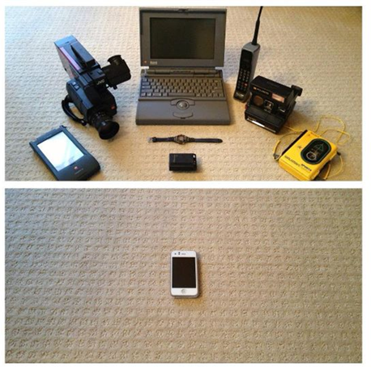
Evolution
In just a decade, cameramen and pilots have seen their roles replaced.
In just a decade, all those separate devices have merged into a single, multifunctional device
Now is the time to upgrade your skills, embrace collaboration, and prepare for the journey ahead.

Slide 8
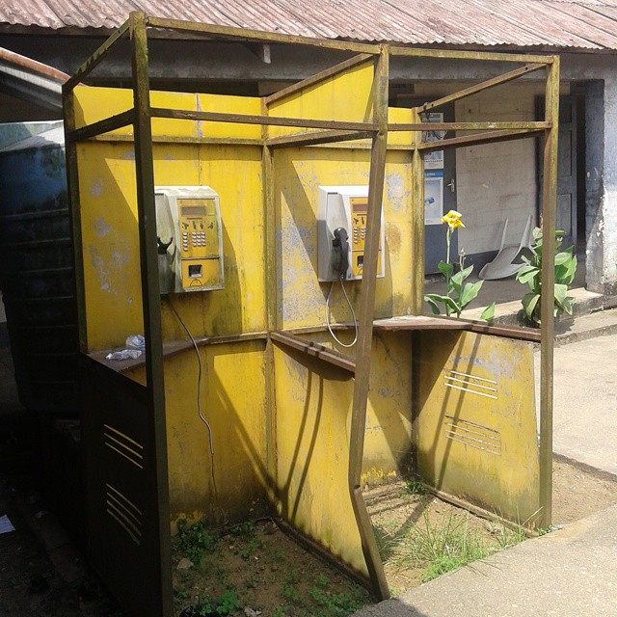
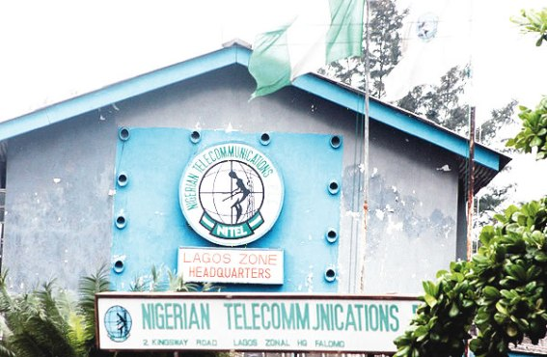
Where are the Typists? What of Nitel Boys?

Slide 9

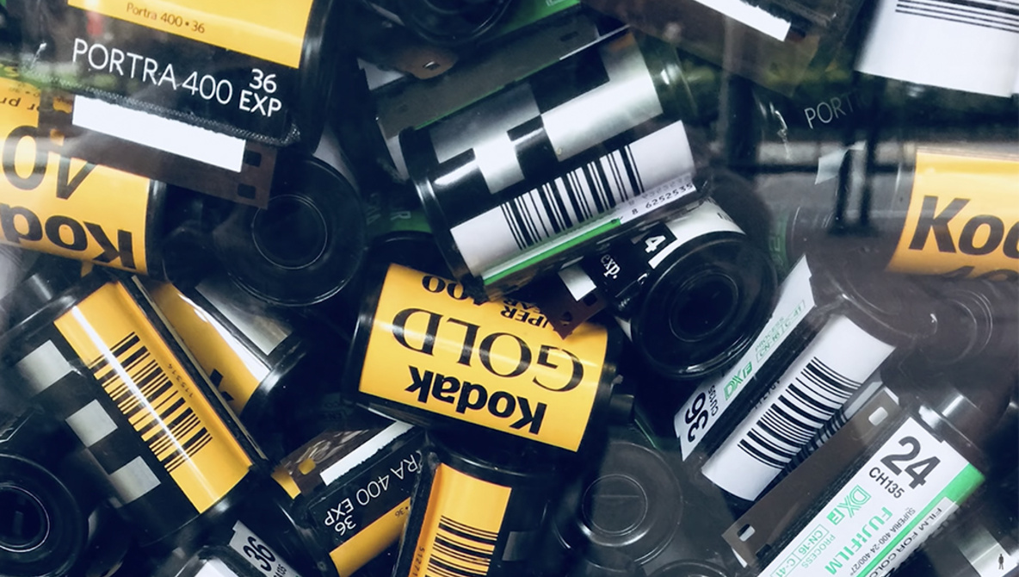
Where is Kodak today?
Remember the Kodak Experience.....

Slide 10
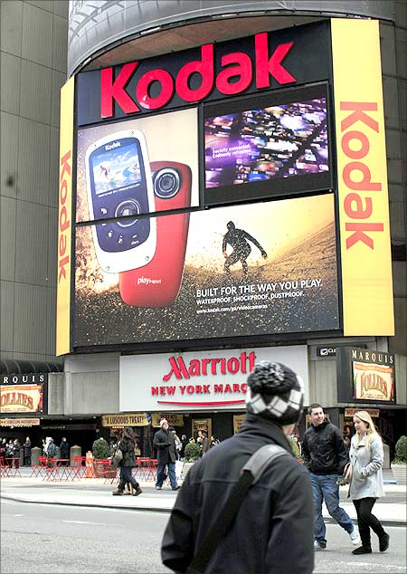
Kodak story
With the introduction of the first automatic snapshot camera more than 110 years ago, Kodak transformed photography to an integral part of people’s lives.
Thus, Kodak got photography out of studios and into family life.
When you bought film for your camera, Kodak film was virtually your only option.
1996 it was ranked the fourth most valuable brand in the United States, behind Disney, Coca-Cola and McDonald’s.
In 1998, Kodak had 170,000 employees and sold 85% of all photo paper worldwide and capturing 90% of the film market.
But in 2012 Kodak filed for bankruptcy.
What happened ?

Slide 11
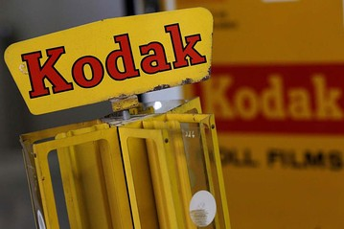

LESSONS FROM Kodak DEMISE
Learn to act fast
Always watch for “The Next Big Thing.”
Never forget where you came from.
Technology may change; but the value you offer shouldn’t.
Be Flexible.
And to make change a part of your culture.

Slide 12
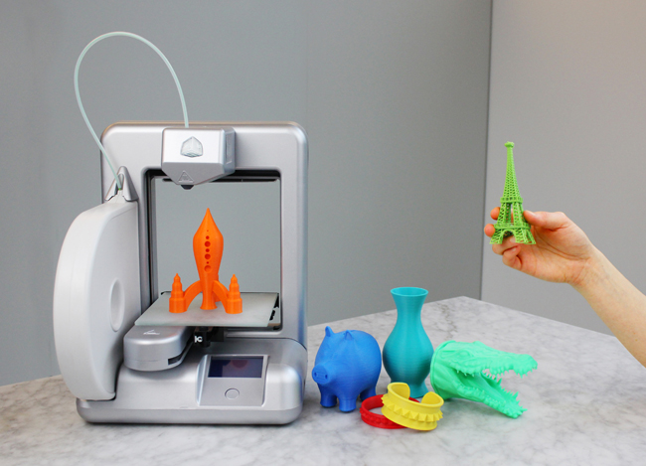
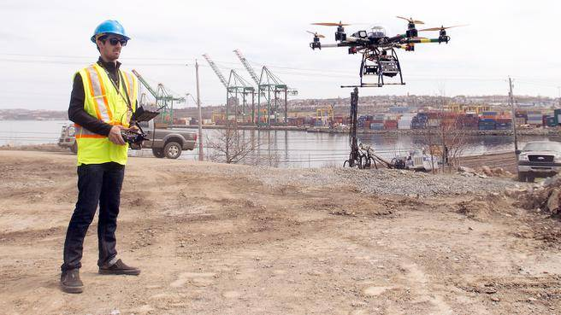
next big things
What happened to Kodak will happen in a lot of industries in the next 10 year - and most people don't see it coming. Did you think in 1998 that 3 years later you would never take pictures on paper film again? It will now happen with
Artificial Intelligence
Health and Medicine
Autonomous and electric cars
Education (Open-Distance–Online)
3D printing
Agriculture
Unmanned Aerial Vehicle
and jobs.
Welcome to the 4th Industrial Revolution. Welcome to the Exponential Age.

Slide 13
Let us go back in History
The Evolution of Emerging Technologies
Notes:
Discuss that it is
A software
Being in use in over 300 countries
However, due to the uniqueness of Nigerian system the developed techniques could not be applied to Nigerian case
The use of AVLPRS
Access control
Toll gate control
Trafic control
Crime fighting
Location of stolen vehicles etc

Slide 14

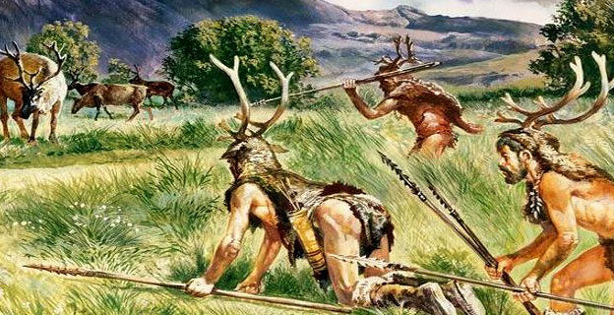
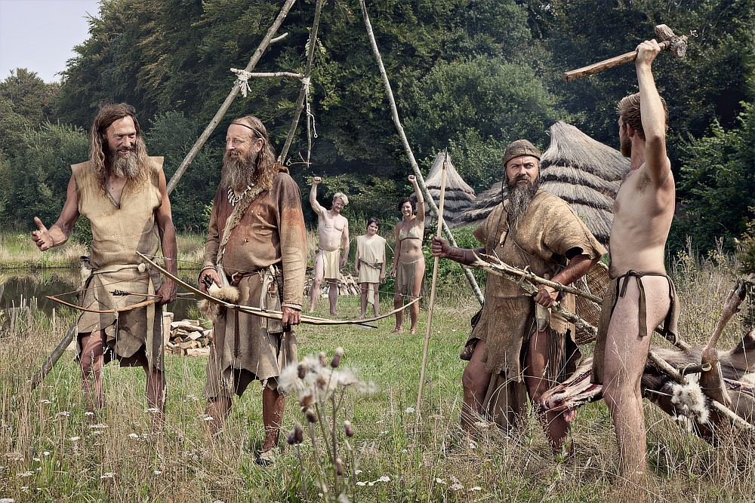
Then, human is one with nature = Harmony
Humans Evolved from a Garden
Hunter-Gatherer Economy

Slide 15

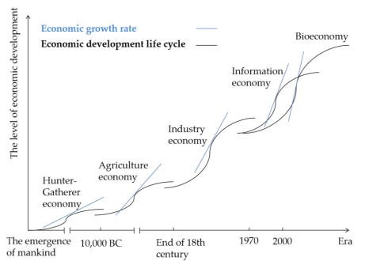
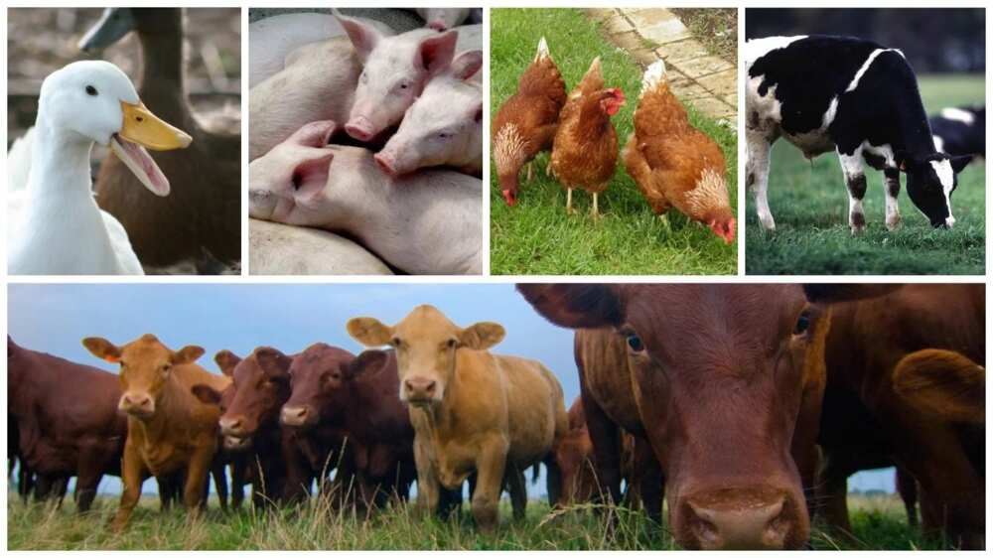
Agriculture Economy

Slide 16
The
Industrial Revolution
Notes:
Discuss that it is
A software
Being in use in over 300 countries
However, due to the uniqueness of Nigerian system the developed techniques could not be applied to Nigerian case
The use of AVLPRS
Access control
Toll gate control
Trafic control
Crime fighting
Location of stolen vehicles etc

Slide 17
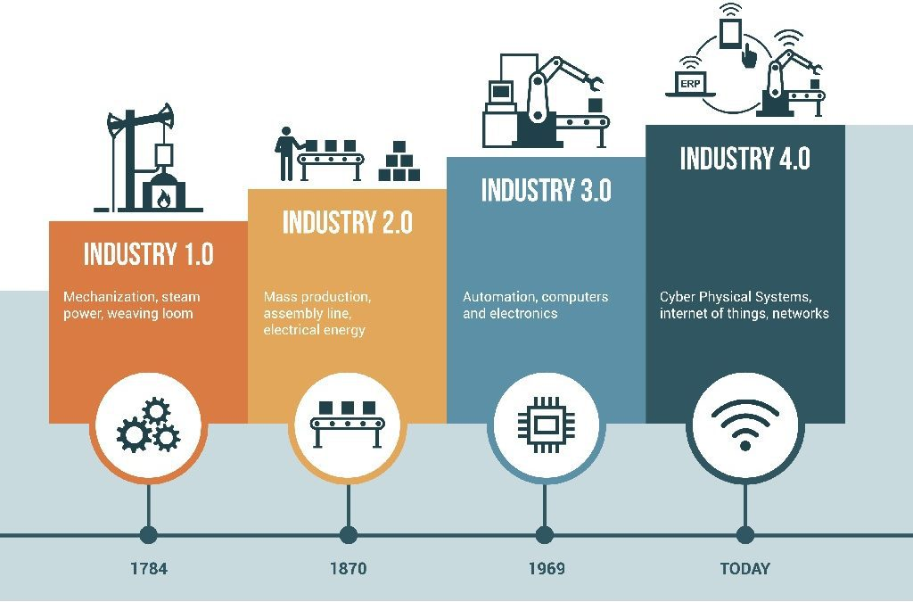
The Industrial Revolutions – 1IR to 4IR
First Industrial Revolution (Mechanization) Transfer of the Ability to Do Work from Man to Machine : Machines, powered by steam and water, took over physical tasks that previously relied on human and animal effort.
Second Industrial Revolution (Electrification). Transfer of the Ability to Produce at Scale : The introduction of electricity, assembly lines, and mass production enabled industries to scale up like never before, revolutionizing manufacturing.
Third Industrial Revolution (Digital Revolution): Transfer of the Ability to Process Information to Computers : With the rise of computers and digital systems, tasks that required human cognitive input—such as calculations, data storage, and communication—were automated.
Fourth Industrial Revolution (Cyber-Physical Systems): Transfer of the Ability to Think and Act Autonomously to Systems: AI, IoT, and robotics allowed machines and systems to not only process information but also make decisions and act independently, integrating the physical and digital worlds seamlessly.

Slide 18
The Industrial Revolutions (IR)
Revolution | Domain | Main Effect
First Industrial Revolution (1IR) | Mechanisation | Transferring the Ability to Do Work from Man to Machine
Second Industrial Revolution (2IR) | Electromechanical System | Transferring the Ability to Produce at Scale and Automate Machine
Third Industrial Revolution (3IR) | Information and Communication Technology (ICT) | Transferring the Ability to Process and Communicate Information to Machine
Fourth Industrial Revolution (4IR) | Cyber-Physical System | Transferring the Ability to Think and Act Autonomously to Machine

Slide 19
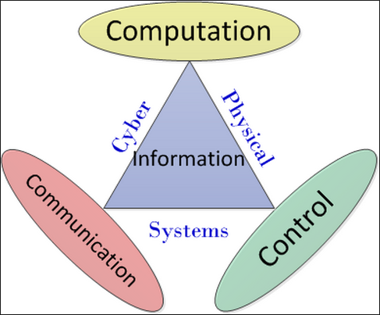
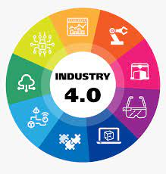
Cyber-Physical Systems (CPS)
Industry 4.0: Principle and Definition
CPS is a system of collaborating computational elements controlling physical entities.
CPS are physical and engineered systems whose operations are monitored, coordinated, controlled and integrated by a computing and communication core.
They allow us to add capabilities to physical systems by merging computing and communication with physical processes.
It is characterized by the integration of cutting-edge technologies

Slide 20
Industry 4.0 and Emerging Technologies
A non-exhaustive list of transformative emerging technologies
Artificial Intelligence
Big Data
Robotics/Mechatronics
Renewable/Clean Energy
Smart Cities
Blockchain
3D Printing
Virtual/Augmented Reality
9. FinTech
10. E-Commerce
11. Shared Economies
12. IoT
13. Nanotechnology/2D Materials
14. Biotechnology/Genetics & Agricultural Innovation
15. Enhanced Waste Management
Emerging technologies represent a wide array of new and developing innovations, Industry 4.0 technologies are a subset of these that are focused specifically on revolutionizing industrial and manufacturing processes.

Slide 21
What are Emerging Technologies?
Emerging technologies are those that are in the nascent stages of their development and adoption, with the potential to create significant future impact.
4. Uncertainty: The full implications and future trajectories of emerging technologies are often uncertain. Their development and adoption can be influenced by various factors, including technological breakthroughs, regulatory changes, market dynamics, and social acceptance.
5. Interdisciplinary Nature: Emerging technologies often arise at the intersection of multiple disciplines, combining advances in fields such as computing, biology, materials science, and engineering to create new capabilities and solutions.
1. Novelty: They are relatively new and have not yet been widely adopted or fully developed. These technologies are in the early stages of their life cycle.
2. Potential Impact: Emerging technologies have the potential to significantly alter industries, economies, and society. They can create new markets, disrupt existing ones, and lead to substantial changes in the way we live and work.
3. Rapid Evolution: These technologies are characterized by rapid advancement and innovation..

Slide 22
Will Artificial Intelligence replace us?
Notes:
Discuss that it is
A software
Being in use in over 300 countries
However, due to the uniqueness of Nigerian system the developed techniques could not be applied to Nigerian case
The use of AVLPRS
Access control
Toll gate control
Trafic control
Crime fighting
Location of stolen vehicles etc

Slide 23
Conceptual Clarification
Artificial Intelligence
Notes:
Discuss that it is
A software
Being in use in over 300 countries
However, due to the uniqueness of Nigerian system the developed techniques could not be applied to Nigerian case
The use of AVLPRS
Access control
Toll gate control
Trafic control
Crime fighting
Location of stolen vehicles etc

Slide 24
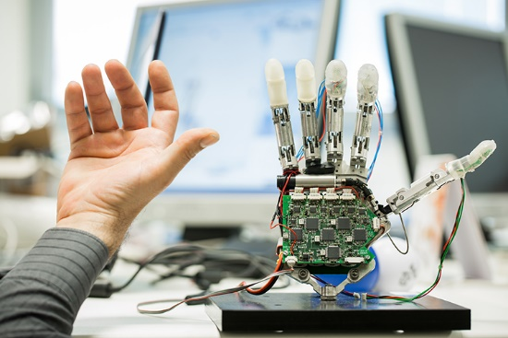

Artificial Intelligence Definition
Simply put:
Artificial
+
Intelligence
=
Artificial Intelligence

Slide 25
What is Artificial Intelligence (AI)?
“Artificial Intelligence (AI) is the transfer of intelligence in man to machine”.
It is the ability of a digital computer or computer-controlled robot to perform tasks commonly associated with intelligent beings.
“A way of making a computer, a computer-controlled robot, or a software think intelligently, in the similar manner the intelligent humans think”
“The art of creating machines that perform functions that require intelligence when performed by people.”
“The study of how to make computers do things at which, at the moment, people are better at.”

Slide 26
AI Generations (AIG)
Gen. | Domain | Main Effect
1st Gen. | Rule-Based AI (Symbolic AI) – The 1950s to 1980s | Key Characteristics: AI systems relied on explicitly programmed rules and logic to make decisions. Examples: Expert systems (like MYCIN and DENDRAL), early chess-playing programs. Limitations: Could not handle uncertainty or learn from data; required extensive human-defined rules
2nd Gen. | Machine Learning & Statistical AI – The 1990s to early 2010s | Key Characteristics: AI systems started learning from data rather than relying solely on predefined rules. Examples: Spam filters, recommendation systems, and early deep learning models. Limitations: Required large datasets and high computational power; struggled with complex reasoning.

Slide 27
AI Generations (AIG)- Cont’d
Gen. | Domain | Main Effect
3rd Gen. | Cognitive & Context-Aware AI (Present and Near Future) | Key Characteristics: AI systems become more context-aware, adaptive, and capable of reasoning beyond statistical patterns. Examples: AI models with better reasoning abilities (e.g., ChatGPT-4, Google DeepMind’s AI agents), multimodal AI, AI-powered decision-making in healthcare and finance. Advancements: AI integrates human-like reasoning, common sense, and emotional intelligence into interactions.
4th Gen | Autonomous AI & AGI (Future Vision) | Key Characteristics: AI achieves Artificial General Intelligence (AGI)—capable of human-like reasoning, creativity, and self-learning across domains. Potential Examples: Fully autonomous robots, AI scientists discovering new theories, AI that can think independently and apply knowledge flexibly. Challenges: Ethical concerns, alignment with human values, control mechanisms, and safety risks.

Slide 28
Application Of AI in Various Fields
AI in Education
AI in Transportation
AI in Healthcare
AI in Fields
AI in Manufacturing
AI in Business
AI in Accounting

Slide 29
How can we use Artificial Intelligence responsibly while upholding Islamic values?
Notes:
Discuss that it is
A software
Being in use in over 300 countries
However, due to the uniqueness of Nigerian system the developed techniques could not be applied to Nigerian case
The use of AVLPRS
Access control
Toll gate control
Trafic control
Crime fighting
Location of stolen vehicles etc

Slide 30
Islam and Knowledge
Notes:
Discuss that it is
A software
Being in use in over 300 countries
However, due to the uniqueness of Nigerian system the developed techniques could not be applied to Nigerian case
The use of AVLPRS
Access control
Toll gate control
Trafic control
Crime fighting
Location of stolen vehicles etc

Slide 31

Islam and Knowledge
Islam encourages every Muslim to seek knowledge and understanding.
The Holy Qur’an and the teachings of Prophet Muhammad (peace be upon him) strongly emphasize learning and reflecting.
Developing new technologies, including Artificial Intelligence, is part of human creativity, which Islam supports when used for good purposes.
Any modern technology is considered permissible when it does not cause harm and is used in a responsible and ethical way.
Muslims are encouraged to participate in scientific and technological development to benefit their communities and the entire world.

Slide 32
Can Artificial Intelligence strengthen Islamic education without replacing teachers?
Notes:
Discuss that it is
A software
Being in use in over 300 countries
However, due to the uniqueness of Nigerian system the developed techniques could not be applied to Nigerian case
The use of AVLPRS
Access control
Toll gate control
Trafic control
Crime fighting
Location of stolen vehicles etc

Slide 33
Prospects of Artificial Intelligence for Muslims
Notes:
Discuss that it is
A software
Being in use in over 300 countries
However, due to the uniqueness of Nigerian system the developed techniques could not be applied to Nigerian case
The use of AVLPRS
Access control
Toll gate control
Trafic control
Crime fighting
Location of stolen vehicles etc

Slide 34
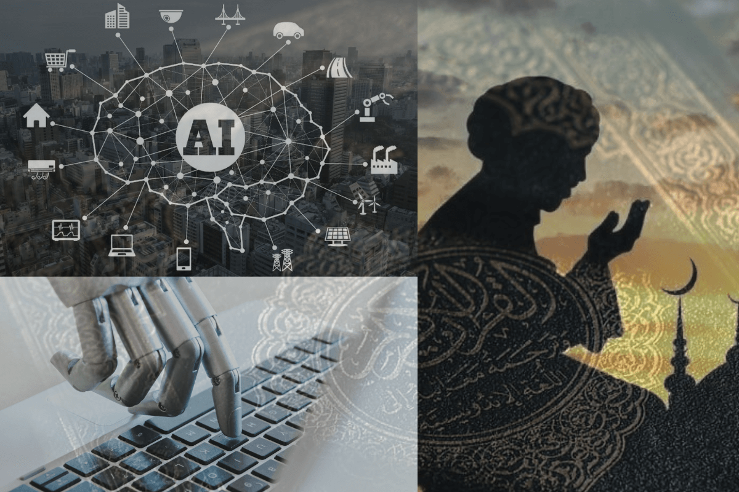
Prospects of Artificial Intelligence
Islamic Education Improvement
Digital Qur’an memorization assistants
Automated Tajweed correction tools
Religious Practice Support
Accurate prayer time calculations
Smart Qiblah direction tools
Arabic Language Support
Accurate Arabic translation systems
Speech-to-text tools for Arabic learners

Slide 35

Prospects of Artificial Intelligence
Access to Islamic Scholarship
Digital libraries of Islamic books
Artificial Intelligence chat systems for verified Islamic information
Strengthening Islamic Finance
Automated financial analysis tools
Improved halal investment screening
Economic and Career Opportunities
New job roles in technology fields
Skills development for Muslim youth

Slide 36
Will Artificial Intelligence create more opportunities than it destroys?
Notes:
Discuss that it is
A software
Being in use in over 300 countries
However, due to the uniqueness of Nigerian system the developed techniques could not be applied to Nigerian case
The use of AVLPRS
Access control
Toll gate control
Trafic control
Crime fighting
Location of stolen vehicles etc

Slide 37
Prospects of Artificial Intelligence for Society
Notes:
Discuss that it is
A software
Being in use in over 300 countries
However, due to the uniqueness of Nigerian system the developed techniques could not be applied to Nigerian case
The use of AVLPRS
Access control
Toll gate control
Trafic control
Crime fighting
Location of stolen vehicles etc

Slide 38
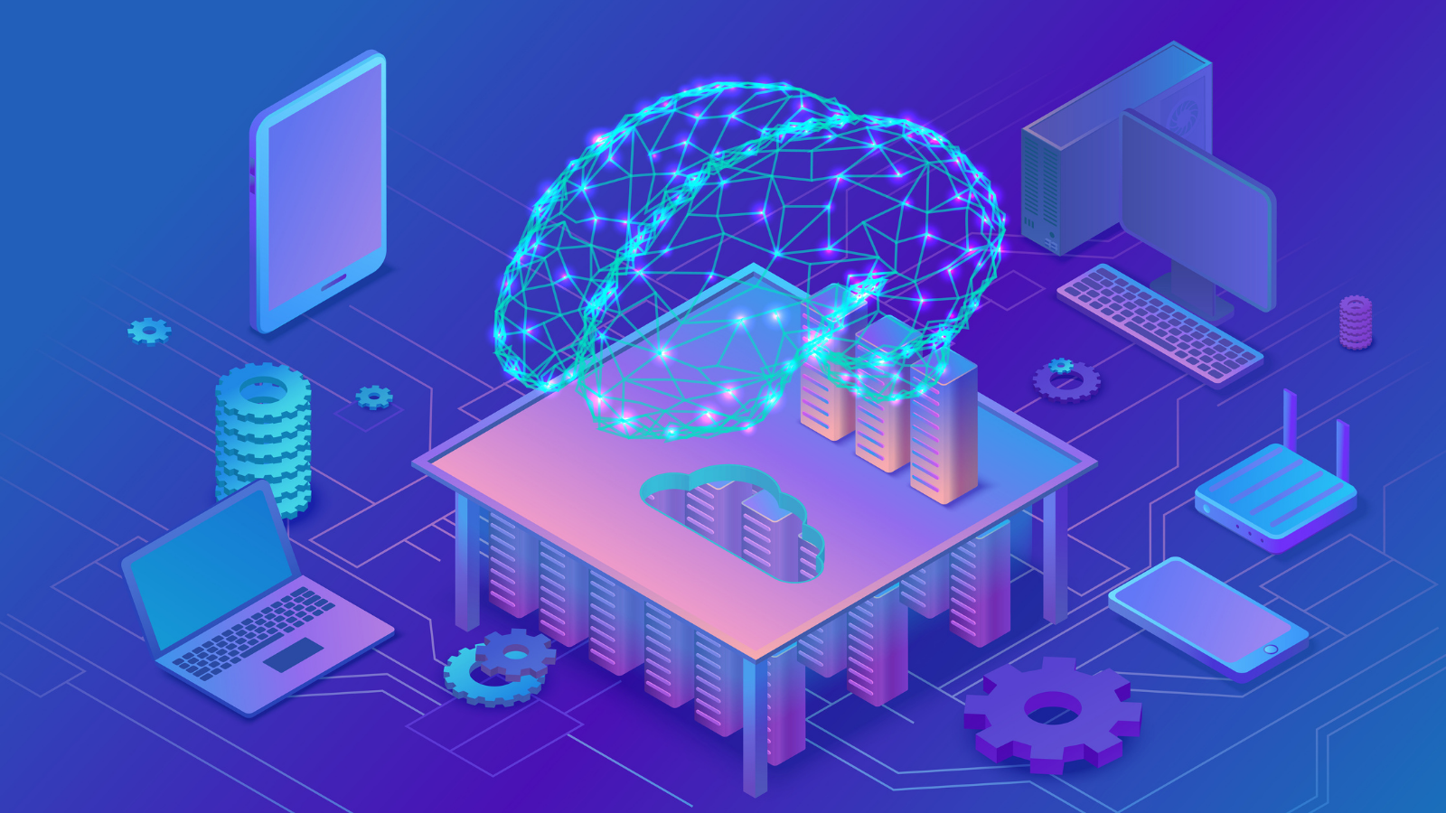
Prospects of Artificial Intelligence
Improved Healthcare
Faster and more accurate medical diagnosis
Early detection of diseases
Modern Transportation
Smart traffic management systems
Safer self-driving vehicles
Enhanced Education
Personalized learning for students
Virtual tutors for any subject

Slide 39
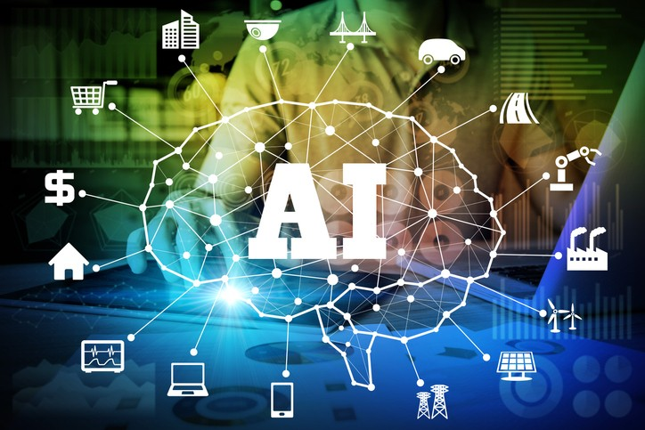
Prospects of Artificial Intelligence
Efficient Agriculture
Improved crop monitoring
Smart irrigation systems
Government and Public Services
Enhanced public safety monitoring
Faster service delivery
Business and Financial Growth
Automated customer service systems
Better market predictions

Slide 40
Will Artificial Intelligence replace human jobs entirely?
Notes:
Discuss that it is
A software
Being in use in over 300 countries
However, due to the uniqueness of Nigerian system the developed techniques could not be applied to Nigerian case
The use of AVLPRS
Access control
Toll gate control
Trafic control
Crime fighting
Location of stolen vehicles etc

Slide 41
Problems and Challenges of Artificial Intelligence
Notes:
Discuss that it is
A software
Being in use in over 300 countries
However, due to the uniqueness of Nigerian system the developed techniques could not be applied to Nigerian case
The use of AVLPRS
Access control
Toll gate control
Trafic control
Crime fighting
Location of stolen vehicles etc

Slide 42
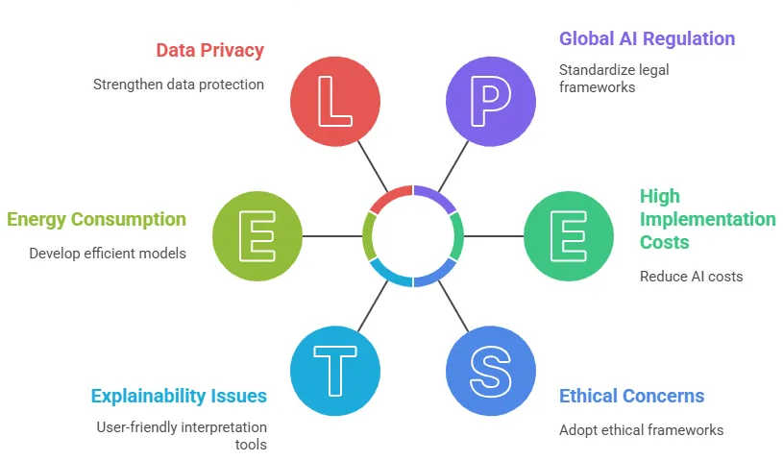
Problems and Challenges of Artificial Intelligence
Loss of Jobs
Machines replacing human workers
Reduced employment in repetitive tasks
Spread of False Information
Artificial Intelligence tools generating misleading content
Difficulty in knowing what is real or fake
Privacy and Data Misuse
Personal information being collected without consent
Surveillance without clear guidelines

Slide 43
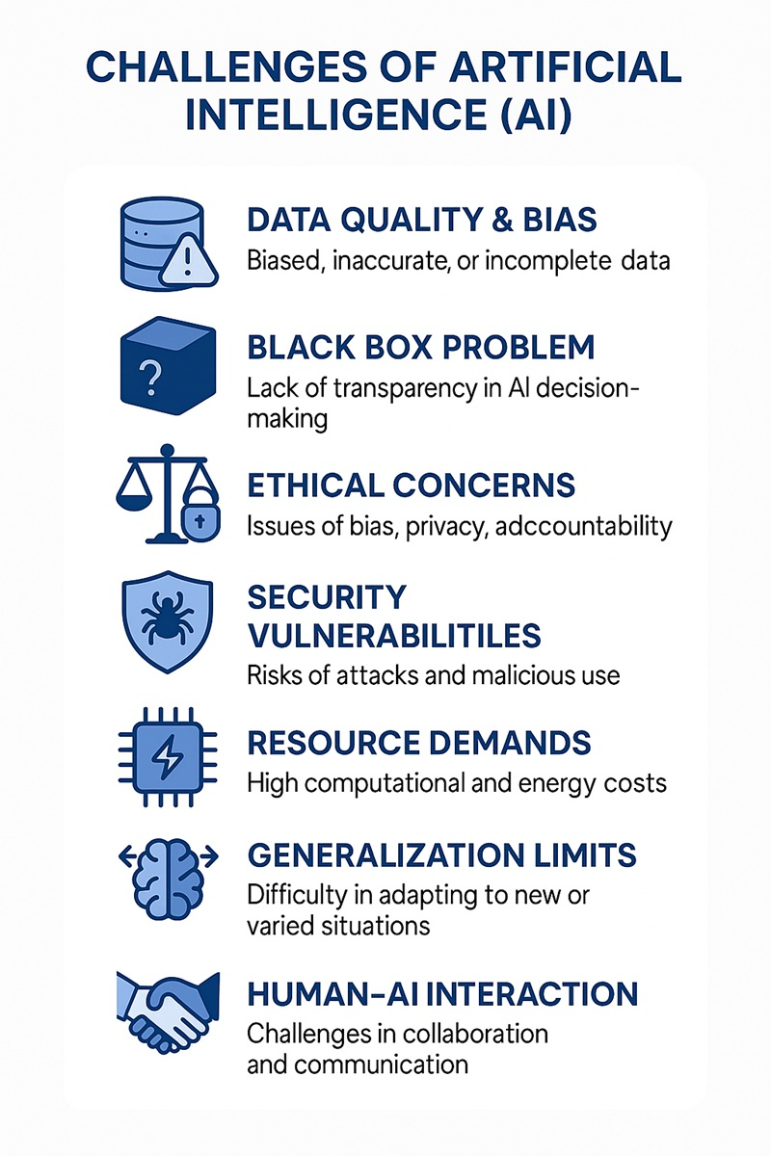
Problems and Challenges of Artificial Intelligence
Bias and Unfair Decisions
Systems making decisions that favor some groups over others
Errors caused by incorrect or incomplete training data
Ethical and Moral Concerns
Use of Artificial Intelligence in warfare
Creation of harmful or immoral content
Overdependence on Technology
Reduced human thinking and creativity
Difficulty functioning without digital tools

Slide 44
How can Islamic principles guide ethical use of Artificial Intelligence?
Notes:
Discuss that it is
A software
Being in use in over 300 countries
However, due to the uniqueness of Nigerian system the developed techniques could not be applied to Nigerian case
The use of AVLPRS
Access control
Toll gate control
Trafic control
Crime fighting
Location of stolen vehicles etc

Slide 45
Islamic Ethical Concerns
Notes:
Discuss that it is
A software
Being in use in over 300 countries
However, due to the uniqueness of Nigerian system the developed techniques could not be applied to Nigerian case
The use of AVLPRS
Access control
Toll gate control
Trafic control
Crime fighting
Location of stolen vehicles etc

Slide 46

Islamic Ethical Concerns
Truthfulness and Honesty
Artificial Intelligence must not be used to deceive others
Generating false or misleading information is against Islamic teachings
Justice and Fairness
Artificial Intelligence systems must not treat people unfairly
Decisions must be balanced and free from discrimination
Protection of Human Dignity
Technology must respect the value of every individual
Artificial Intelligence should not humiliate, harm, or degrade anyone

Slide 47

Islamic Ethical Concerns
Ethical Use of Knowledge
Islamic teachings encourage responsible use of knowledge
Artificial Intelligence developers must consider moral consequences
Prevention of Harm
Any technology that causes harm must be avoided
Artificial Intelligence applications must be safe and beneficial
Privacy Protection
Personal information must be protected at all times
Islam prohibits spying, exposing secrets, or invading privacy

Slide 48
How do we balance technological progress with spiritual responsibilities?
Notes:
Discuss that it is
A software
Being in use in over 300 countries
However, due to the uniqueness of Nigerian system the developed techniques could not be applied to Nigerian case
The use of AVLPRS
Access control
Toll gate control
Trafic control
Crime fighting
Location of stolen vehicles etc

Slide 49
Islamic Guidelines for Using Artificial Intelligence
Notes:
Discuss that it is
A software
Being in use in over 300 countries
However, due to the uniqueness of Nigerian system the developed techniques could not be applied to Nigerian case
The use of AVLPRS
Access control
Toll gate control
Trafic control
Crime fighting
Location of stolen vehicles etc

Slide 50
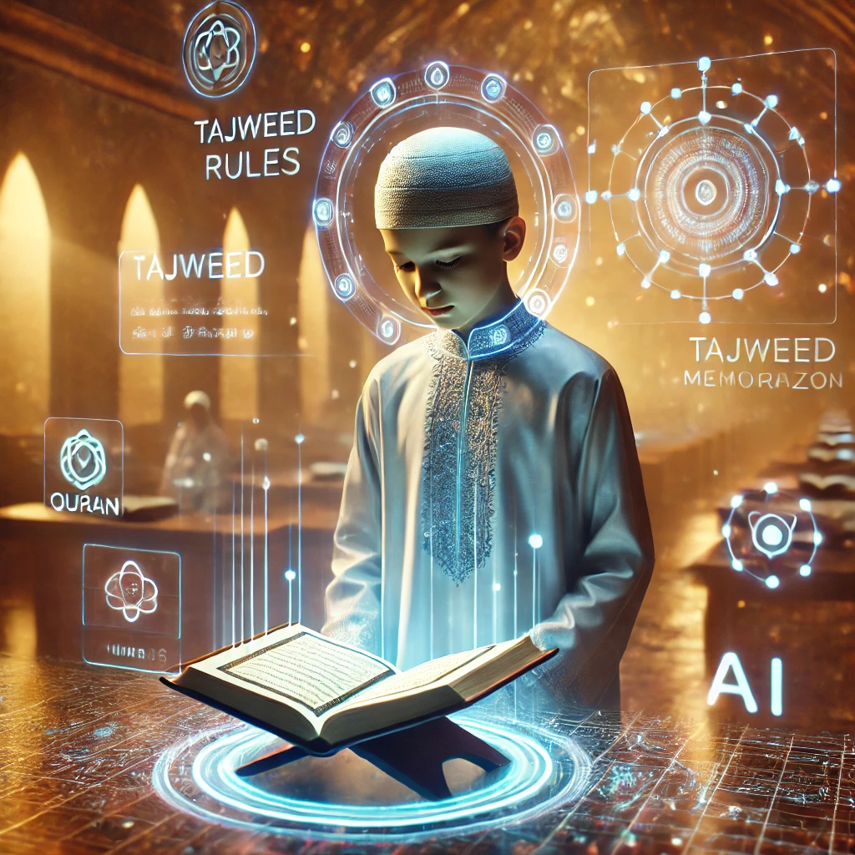
Islamic Guidelines for Using Artificial Intelligence
Promote Fairness and Transparency
Systems should be open, understandable, and honest
Decisions made by Artificial Intelligence must be explainable
Use Technology for Halal and Beneficial Purposes
Only use Artificial Intelligence for lawful and positive activities
Avoid harmful, destructive, or immoral uses
Maintain Human Responsibility
Humans must stay in control of important decisions
Artificial Intelligence should assist, not replace, human judgment

Slide 51
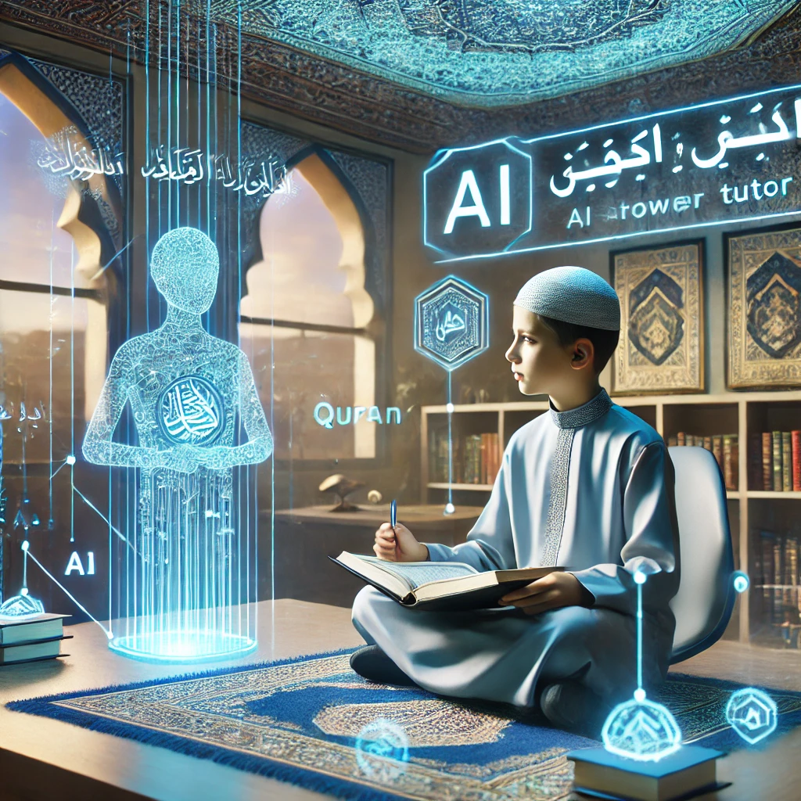
Islamic Guidelines for Using Artificial Intelligence
Balance Technology with Spiritual Life
Do not allow technology to distract from prayer, worship, and moral duties
Use Artificial Intelligence in ways that strengthen faith, not weaken it
Protect Privacy and Personal Information
Secure information to prevent misuse
Respect Islamic rules on protecting the dignity and privacy of individuals
Avoid Deception and False Content
Do not use Artificial Intelligence to create misleading or fake messages

Slide 52
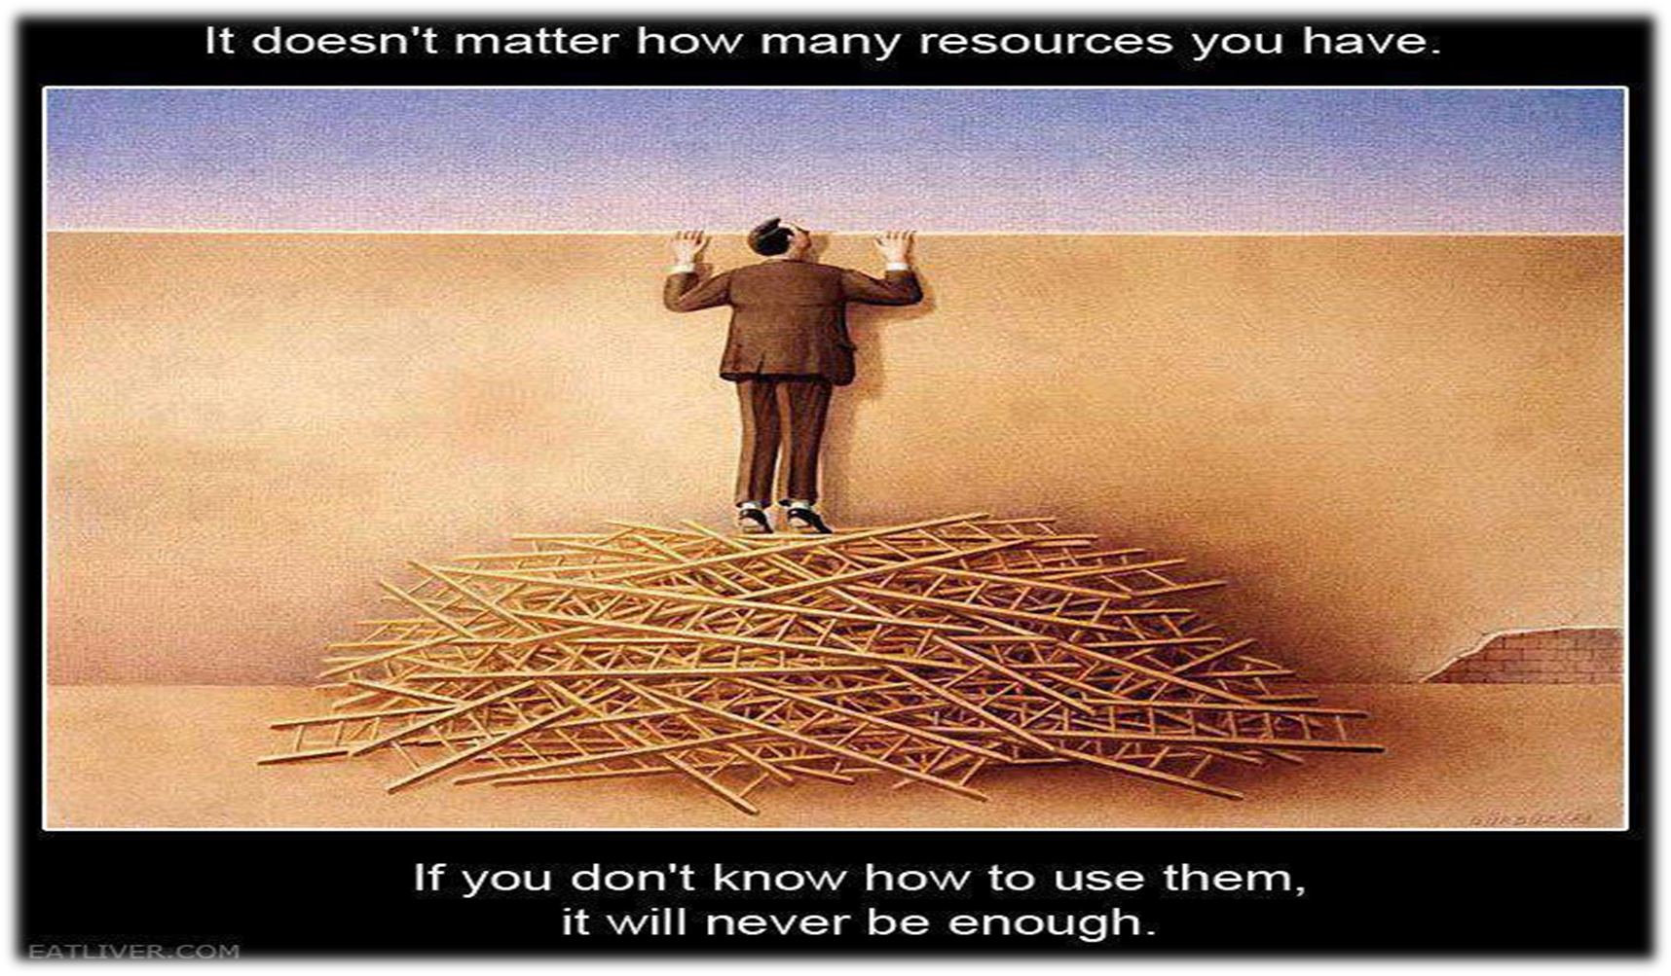
Call to Action

Slide 53
Conclusion
Artificial Intelligence offers vast benefits for Muslims and society, from education and healthcare to economic growth and innovation.
However, it also presents challenges such as job loss, privacy risks, and ethical dilemmas.
Guided by Islamic principles of justice, honesty, and responsibility, Muslims can use Artificial Intelligence ethically and responsibly.
By balancing technological advancement with spiritual and moral duties, Artificial Intelligence can serve humanity positively while strengthening the well-being of the Ummah.
Notes:
Discuss that it is
A software
Being in use in over 300 countries
However, due to the uniqueness of Nigerian system the developed techniques could not be applied to Nigerian case
The use of AVLPRS
Access control
Toll gate control
Trafic control
Crime fighting
Location of stolen vehicles etc

Slide 54

Acknowledgement
I would like to express my heartfelt gratitude to the organizer for putting together this incredible event.
Special thanks to the person who prepared the engaging slides, which greatly enhanced the presentation.
I am truly grateful to the attentive listeners whose presence made this experience worthwhile.
Lastly, I extend my appreciation to all the enthusiastic participants who actively contributed to the discussions.
Your support and involvement have made this event a resounding success.
Thank you all!

Slide 55
Thank you for listening.

